Slide 1
House Price Prediction Project Number : 119 Mentor: Mr. Navaljeet Singh Arora

Slide 2

Group Members:-
Akhil Pandey (211B032)
Bicky Kumar (211B094)
Priyadarshi Kumar(211B227)

Slide 3
Introduction
Problems faced during buying a house:
Buying a house is a stressful thing.
Buyers are generally not aware of factors that influence the house prices.
Many problems are faced during buying a house.
Hence real estate agents are trusted with the communication between buyers and sellers as well as laying down a legal contract for the transfer. This just creates a middleman and increases the cost of houses.

Slide 4
Dependency:
They believe that it depends upon:
The square foot area
Neighbourhood
The no. of bedrooms
But it depends upon many factors also……such as:
No. of storage
Area outside the house
Rooms on one floor

Slide 5
Project summary
Our project is a machine learning website, based on certain specification of your future home it will try to guess the most accurate price.
Information such as state, city, area, stores ,etc.

Slide 6
Key Factors Influencing House Prices Understanding the Variables Affecting Market Value
Number of storage areas
More storage can raise property value, appealing to buyers seeking organization.
Outdoor space
Gardens or patios enhance appeal and can increase market value.
Room configuration
Layouts such as single-floor designs may be preferred by specific demographics.
Local amenities
Proximity to schools, parks, and shopping centers can drive demand and higher prices.

Slide 7
Features
Location: Neighborhood and access to amenities.
Size: Total square footage and lot size.
Bedrooms/Bathrooms: Count of each.
Age: Year built or property age.
Type: Single-family, condo, etc.
Condition: Overall state and renovations.
Parking: Availability of garages or off-street options.
Outdoor Space: Gardens or decks.
Market Trends: Recent local sales and price movements.
Economic Factors: Local job market conditions.
School Quality: Ratings of nearby schools.
Transportation Access: Proximity to public transit.

Slide 8
Model Training and Evaluation Training a model involves feeding it data and optimizing its parameters to achieve high accuracy. Data Split Divide the data into training and testing sets for model evaluation. Model Training Train the chosen algorithm on the training data to learn relationships. Model Evaluation Assess the model's performance on the unseen testing data using metrics like Mean Squared Error.

Slide 9

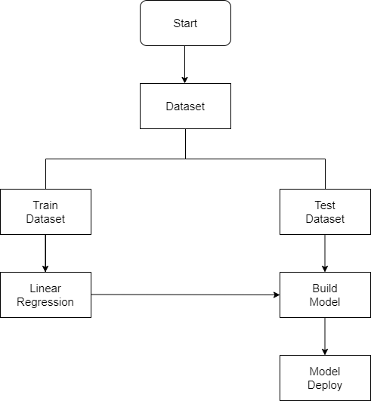
Block Diagram

Slide 10
Data Pre-Processing
Data Cleaning
Statistical Analysis
Feature Construction
Identifying Outliers
Data Conversion
Collinearity Problem
Data Visualization

Slide 11

Tools and Technologies Utilized

Slide 12
HOW IT WORKS ?
Collecting Data:- First step was to collect data we collected data from different sources & merged together to form our training data set.
Then We Trained The module using machine learning algorithm which in this case is multiple linear regression.
Based on the generated graphs we predict the cost of the house.

Slide 13
Challenges and Limitations
House price prediction faces numerous challenges and limitations.
Property Complexity
Each house has unique features and characteristics that can be challenging to quantify.
Market Volatility
Economic fluctuations and unforeseen events can significantly impact house prices.
Data Availability and Accuracy
Reliable and comprehensive data may be scarce, incomplete, or inaccurate.

Slide 14
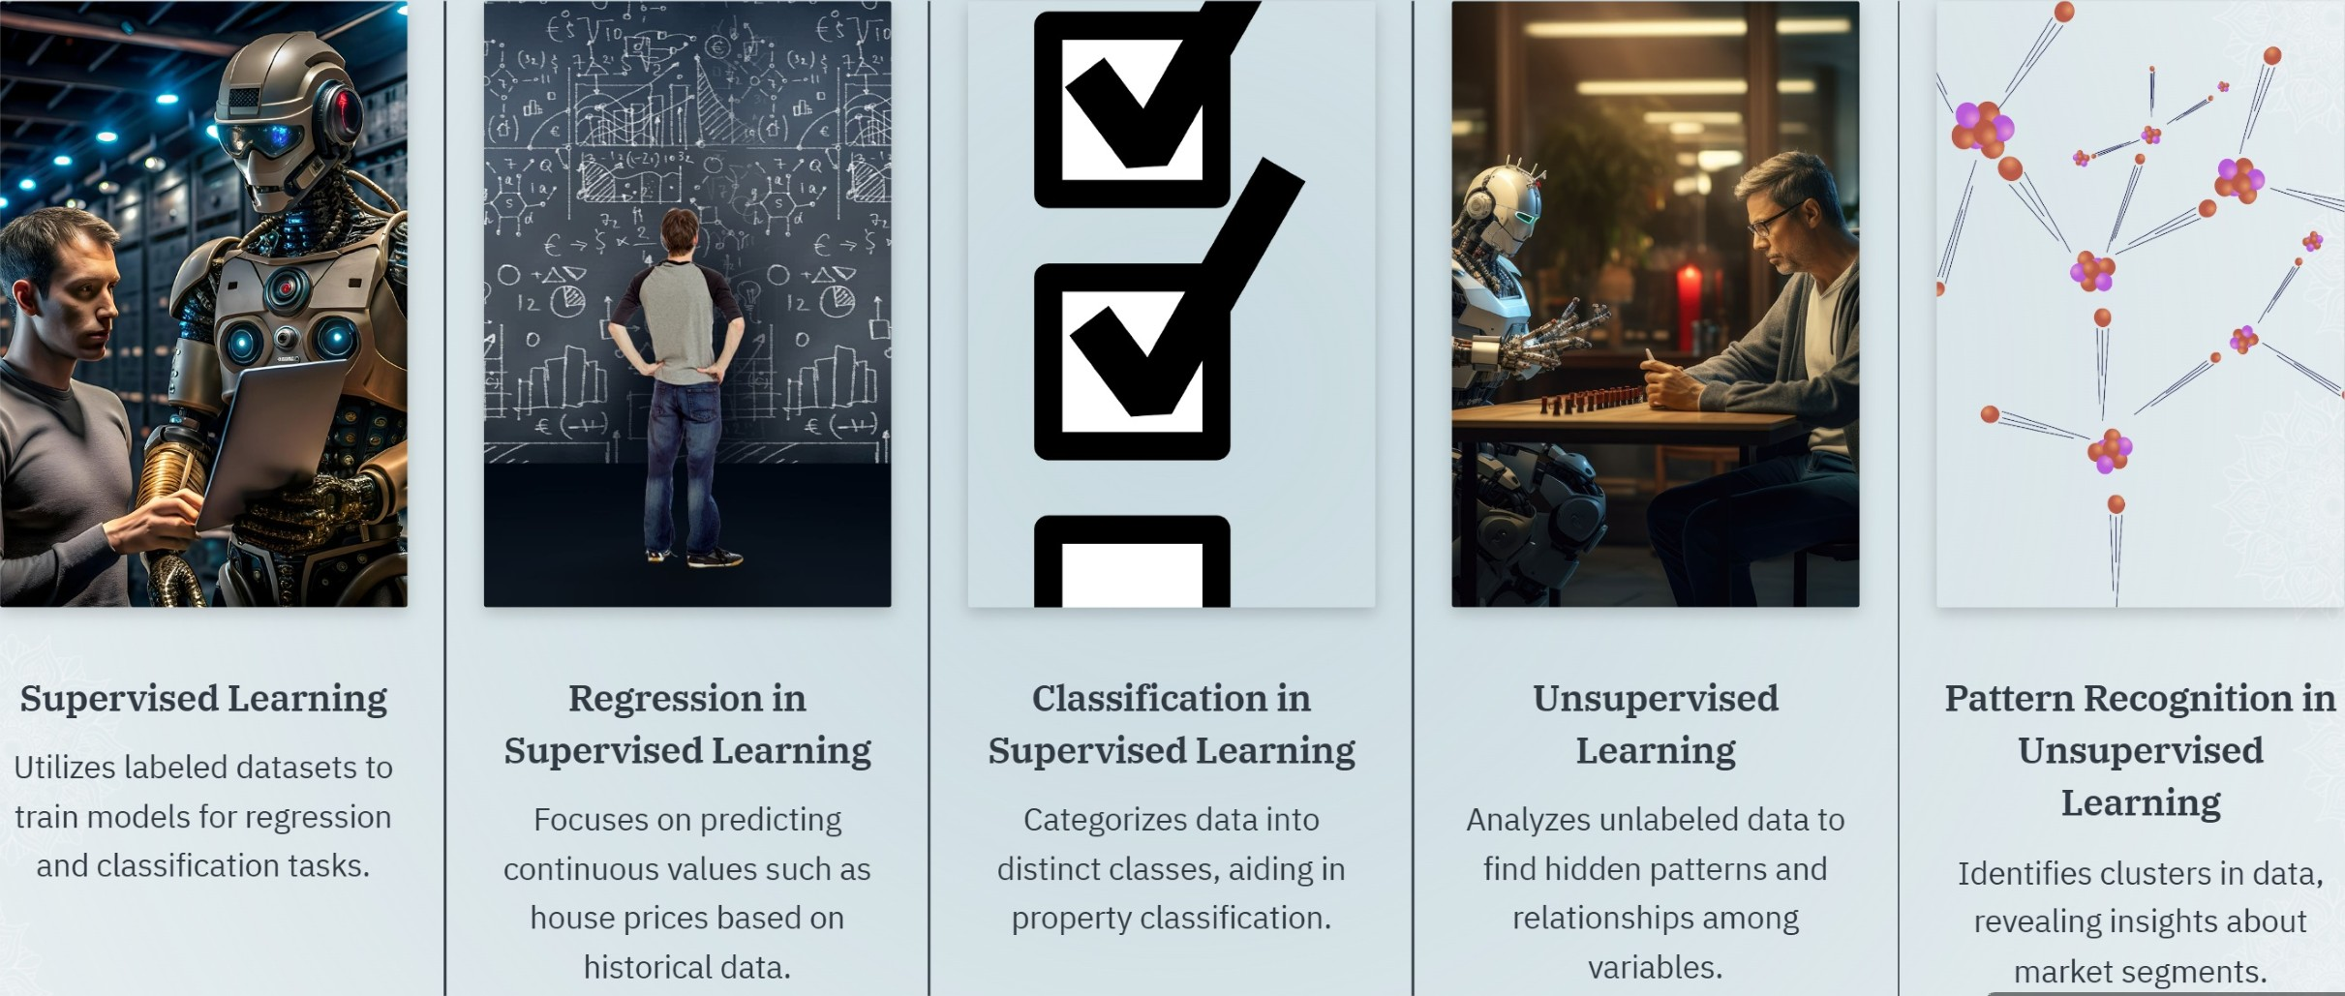
Understanding Machine Learning Methodologies Exploring Supervised and Unsupervised Learning for House Price Prediction

Slide 15
Real-World Applications of House Price Prediction
- Assists homebuyers in making informed decisions
- Guides real estate investors in identifying profitable opportunities
- Helps policymakers in urban planning and housing policies
- Provides financial institutions with tools for property valuation
- Enables real estate agents to enhance customer interactions

Slide 16
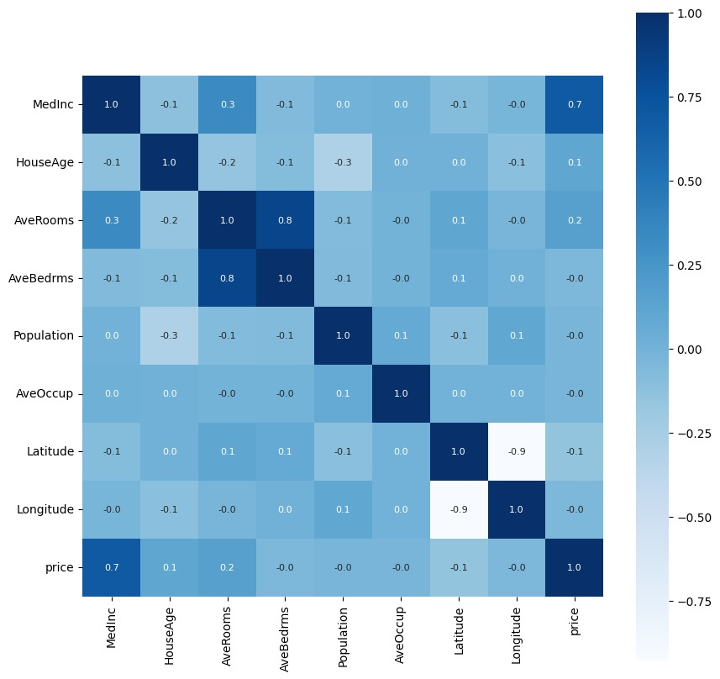

Slide 17
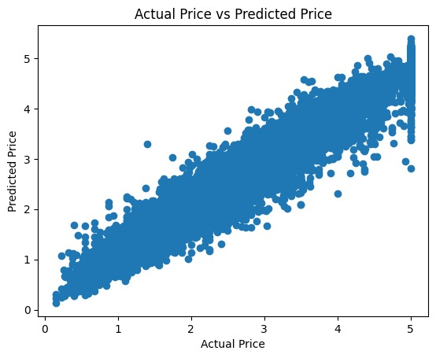
Result:-

Slide 18
Conclusion:-
In conclusion, house price prediction is an important problem in real estate markets that can be addressed using machine learning models. By leveraging historical data and relevant features, such as location, size, and market trends, machine learning models can provide accurate predictions of house prices, which can be used by various stakeholders, including homebuyers, sellers, real estate agents, and investors.
The success of a house price prediction model depends on several factors, including the quality and quantity of data, the choice of features, the selection of a suitable machine learning model, and the appropriate training and validation procedures. Additionally, effective communication and collaboration with stakeholders are essential for ensuring that the model meets the specific needs and goals of the project.

Slide 19
Future Scope
Incorporating advanced machine learning models like neural networks
- Expanding the dataset for better accuracy
- Integrating real-time market data for dynamic predictions
- Adding more user-friendly features to the web application
- Exploring global market predictions and regional customizations

Slide 20
Refrences
C. Zhan, Z. Wu, Y. Liu, Z. Xie and W. Chen, "Housing prices prediction with deep learning: an application for the real estate market in Taiwan," 2020 IEEE 18th International Conference on Industrial Informatics (INDIN), Warwick, United Kingdom, 2020, pp. 719-724, doi: 10.1109/INDIN45582.2020.9442244. keywords: {Deep learning;Biological system modeling;Image processing;Time series analysis;Buildings;Predictive models;Prediction algorithms;Deep learning;housing prices prediction;time series},
K. Chen and J. Huang, "Research on the Design and Application of House Price Prediction Algorithms and Model Based on Machine Learning," 2023 International Conference on Internet of Things, Robotics and Distributed Computing (ICIRDC), Rio De Janeiro, Brazil, 2023, pp. 815-821, doi: 10.1109/ICIRDC62824.2023.00154. keywords: {Industries;Machine learning algorithms;Service robots;Urban areas;Machine learning;Predictive models;Prediction algorithms;Machine Learning;Algorithm;Housing Prices Prediction},

Slide 21
THANK YOU

